Slide 1

Diamond Price Estimation
Kutay Erkan
25.12.2018

Slide 2
Agenda
The Dataset
Feature Engineering
Exploratory Analysis
Label Encoding
Model Selection – Decision Tree
Decision Tree Hyperparameter Tuning
Model Selection – Linear Regression
Final Performance & Comparison
Comments & Discussion

Slide 3
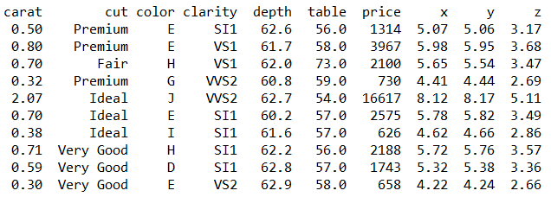
The Dataset
1 target, 10 features
Color → D: best, J: Worst
Clarity → FL (Flawless), IF, VVS1, VVS2, VS1, VS2, SI1, SI2, I1, I2, I3
Depth, Table → To be explained
No missing data, +53k samples

Slide 4
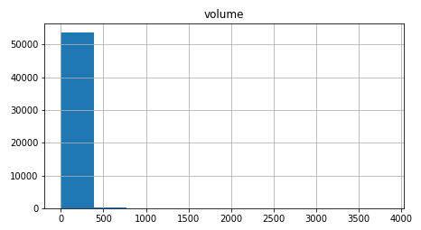
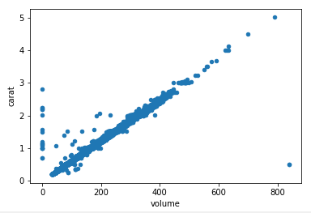
Feature Engineering
df['volume'] = df['x'] * df['y'] * df['z']

Slide 5
Feature Engineering
df['volume'] = df['x'] * df['y'] * df['z']

Slide 6
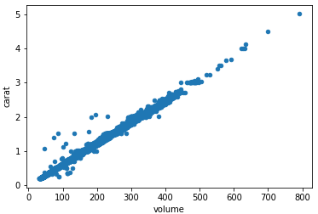
Feature Engineering
df['volume'] = df['x'] * df['y'] * df['z']

Slide 7
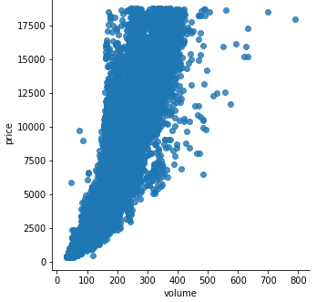
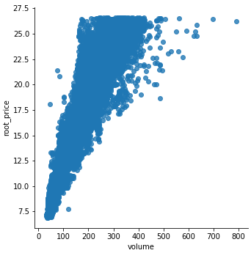
Feature Engineering
df['root_price'] = np.cbrt(df['price'])

Slide 8
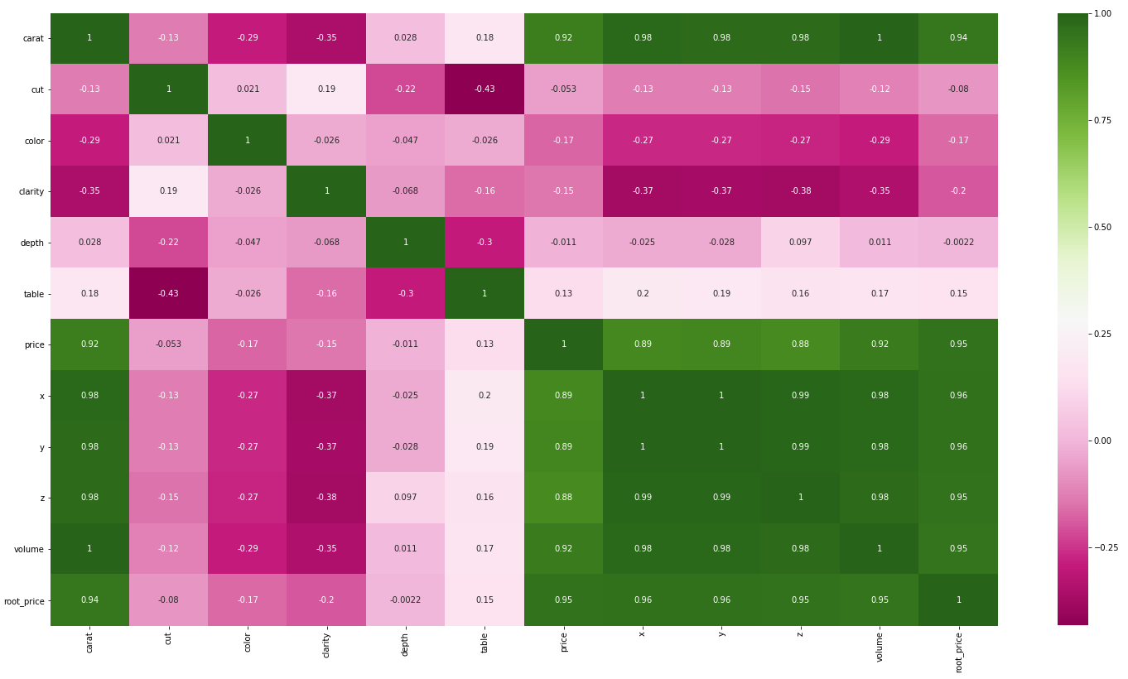
Exploratory Analysis

Slide 9
Exploratory Analysis
?
?
?
?
?

Slide 10
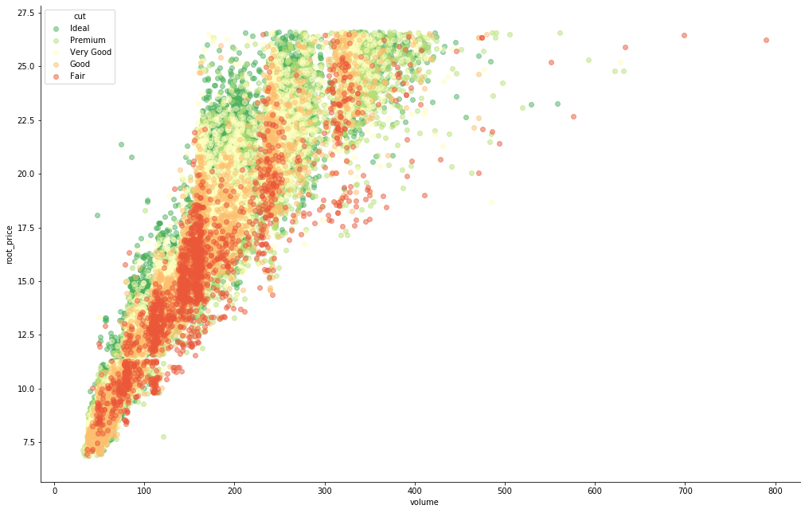
Exploratory Analysis - Cut

Slide 11
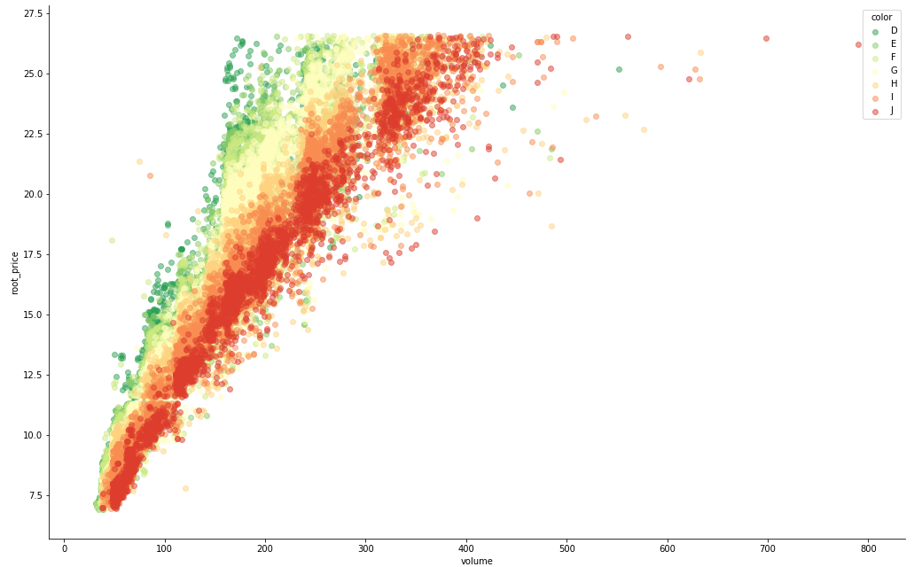
Exploratory Analysis - Color

Slide 12
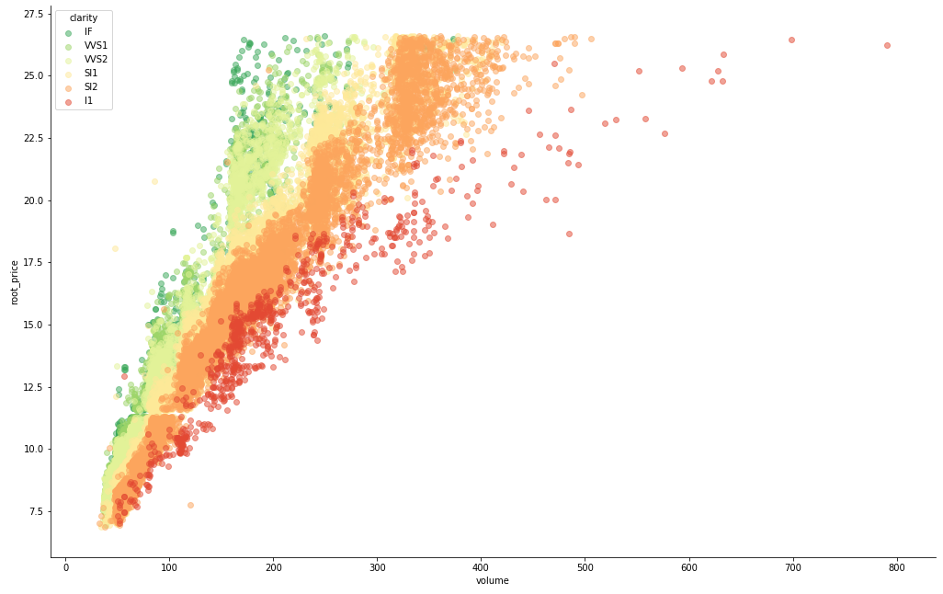
Exploratory Analysis - Clarity

Slide 13
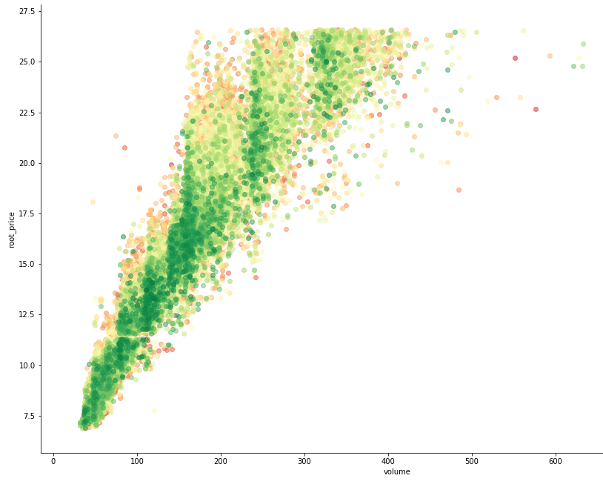
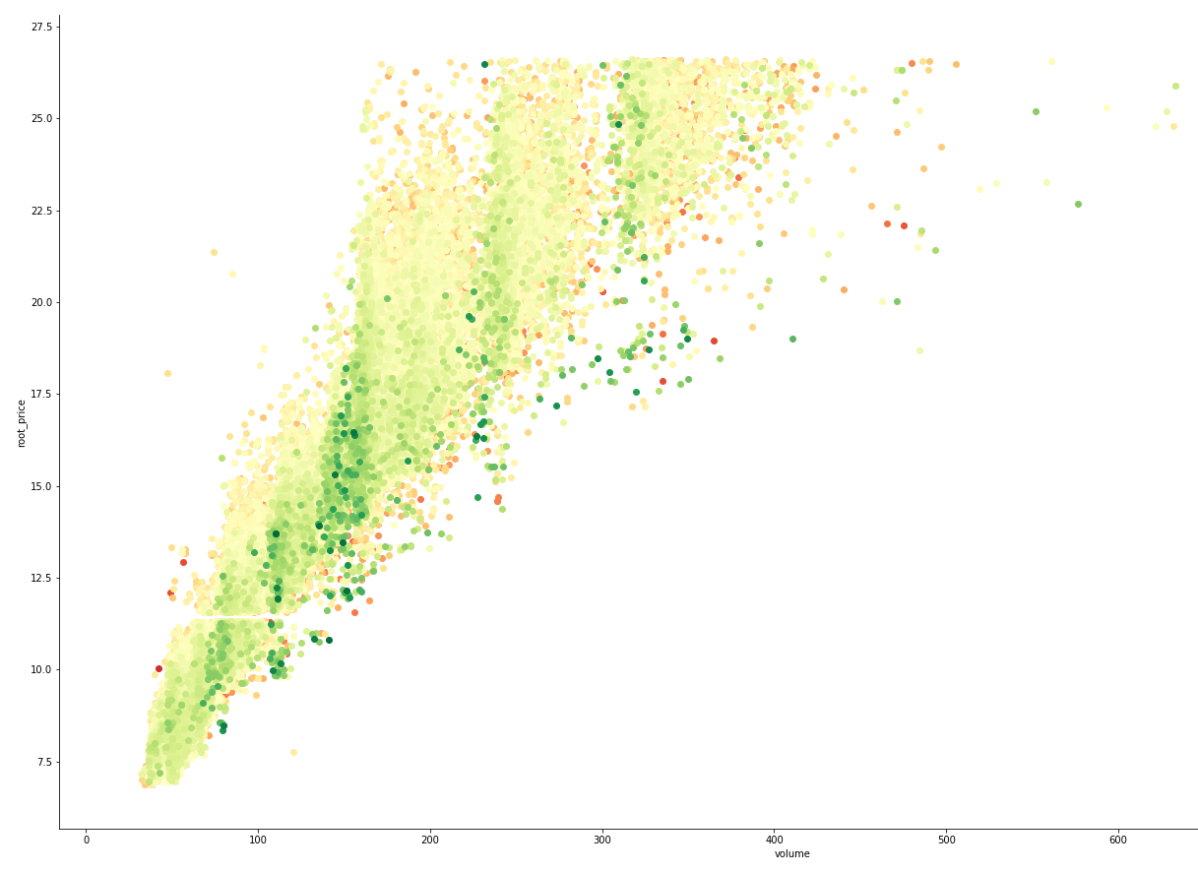
Exploratory Analysis - Table & Depth

Slide 14
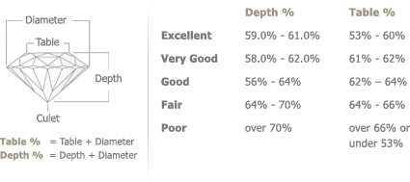
Exploratory Analysis - Table & Depth
Source: https://www.torresjewelco.com.au/diamonds/education/depth-table-percentage.html

Slide 15
Label Encoding
df['cut']
{'Fair': 1, 'Good': 2, 'Very Good': 3, 'Premium': 4, 'Ideal':5}
df['color']
{'J': 1, 'I': 2, 'H': 3, 'G': 4, 'F':5, 'E':6, 'D':7}
df['clarity']
{'I3': 1, 'I2': 2, 'I1': 3, 'SI2': 4, 'SI1':5,
'VS2':6, 'VS1':7, 'VVS2': 8, 'VVS1':9, 'IF':10, 'FL':11}

Slide 16
Train/Validation/Test Split
Separation
Train: %50
Validation: %25
Test: %25
Strafitication
100 bins on the target using np. digitize, as root_price is continuous
Shuffling
Dataset is ordered on price when imported

Slide 17
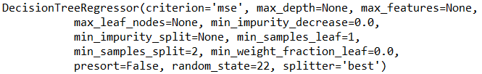

Model Selection – Decision Tree
Default Decision Tree regressor on training data

Slide 18
Decision Tree Hyperparameter Tuning
GridSearchCV is used
grid={"max_depth":[1,2,3,4,5,6,7,8,9,10,11,12]
"min_samples_split":[10,20,50,100],
"min_samples_leaf":[1,5,10,20,50,100]}

Slide 19
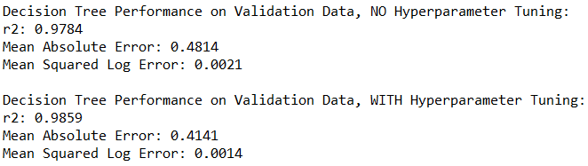
Model Selection – Decision Tree
Decision Tree regressor on validation data, w/ or w/o tuning

Slide 20
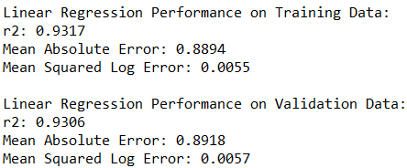
Model Selection – Linear Regression
Linear Regression with the following (rounded) formula:
Price = (-4.46 + (Volume*0.07) +(Clarity*0.5)+(Color*0.4)+(Cut*0.09)+(Table*0.03)+(Depth*0.05))^{^3}

Slide 21
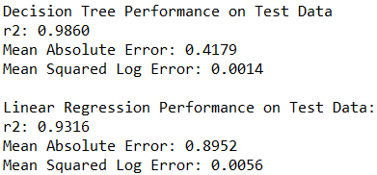
Final Performance
1

Slide 22
Comments & Discussion
Cube root assumption for price ~ volume might be researched further
Cut, table, and depth might be combined
Decision tree might be smaller for interpretability
Depth, table must be transformed for better usability in Linear Regression!
New values with possibly higher-than-average depth or table will predict bad results

